Slide 1
MeatSpec: Enabling Ubiquitous Meat Fraud Inspection through Consumer-Level Spectral Imaging
Haiyan Hu*, Yinan Zhu*, Baichen Yang*, Hua Kang†, Shanwen Chen*, Qian Zhang*
*The Hong Kong University of Science and Technology, † Noah’s Ark Lab, HUAWEI
ACM MobiCom 2024
Notes:
Hello, everyone. I’m HU Haiyan, from the Hong Kong University of Science and Technology. I’m very glad here to introduce our work: MeatSpec: Enabling Ubiquitous Meat Fraud Inspection through Consumer-Level Spectral Imaging.

Slide 2
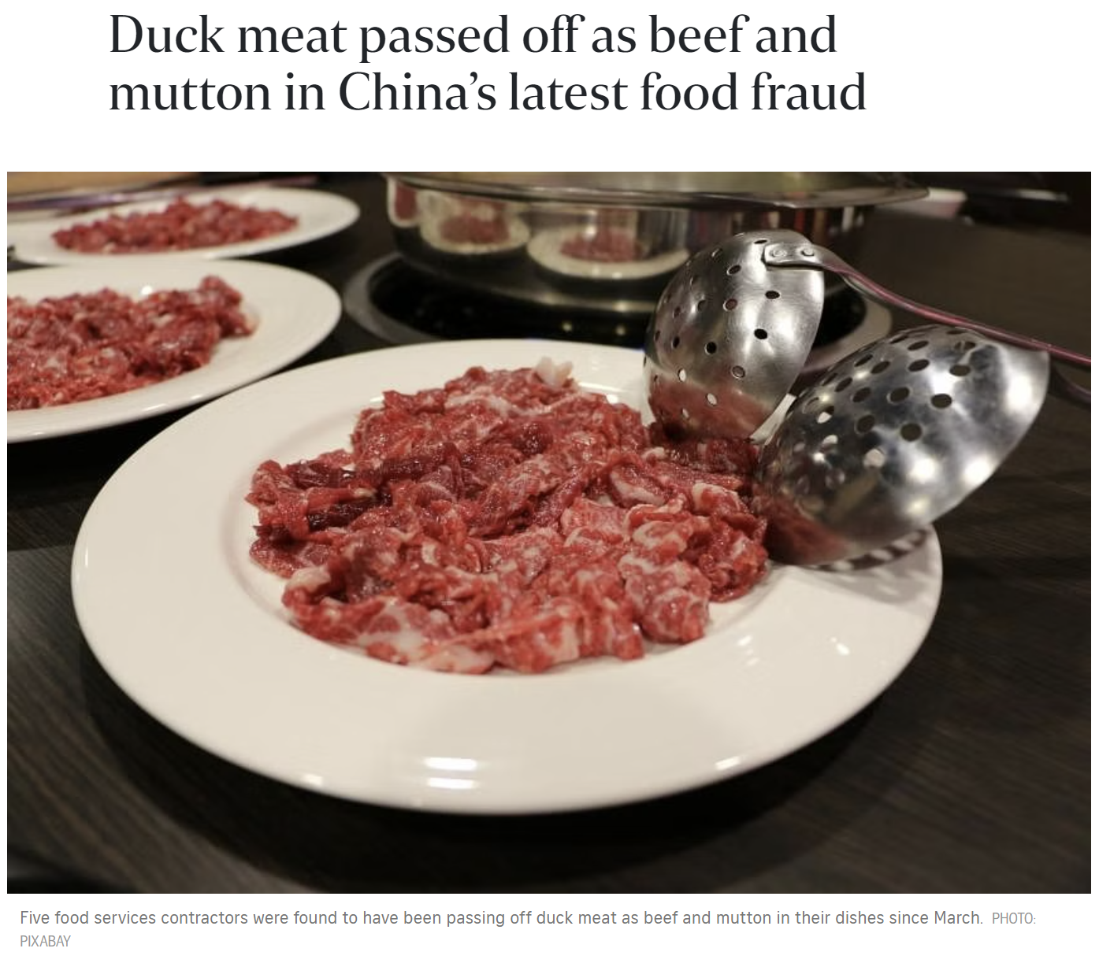
Meat fraud is a growing economic and health issue
Acts of fraud relating to meat products are ongoing, and a global economic and health issue.
Food fraud inflict ≈$40 billion/year damages globally
Causing food poisoning, allergies, religion issues
Notes:
We can see many meat fraud related reports world-wide ever year, which is a growing economic and health issues. For individuals, it can cause food poisoning, allergies, as well as religion issues for the consumers.

Slide 3
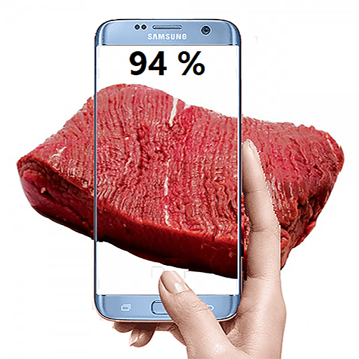
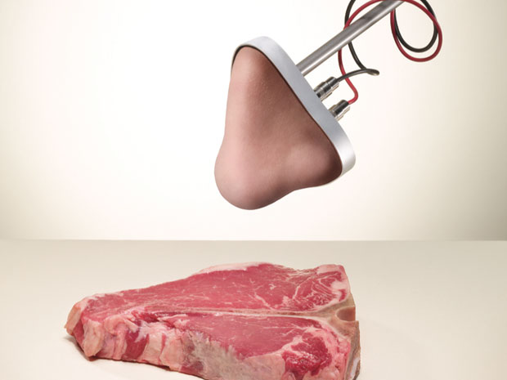
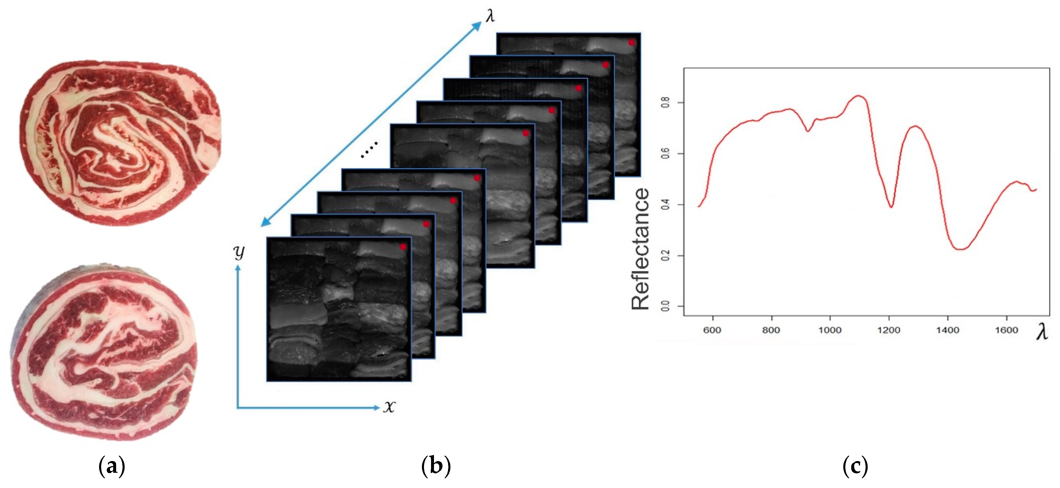
Current meat fraud detection solution is not sufficient
Meat adulteration is a complex problem and challenging to detect.
43.7%
Additives
40.9%
Illegal imports
12.6%
Substitution
End-of-chain nodes
Meat Fraud Risk
User friendly
Complex
Laboratory
Limited capability
Poor accuracy
Camera
E-nose
Expensive
Insufficient Spot Check
Hyperspectral
[1] Xiaoman Li et al. “Meat food fraud risk in Chinese markets 2012–2021.” Science of food 2023.
[2] Saskia M van Ruth et al. “Which Company Characteristics Make a Food Business at Risk for Food Fraud?” Foods 2021.
Notes:
Meat fraud is a complex issue involving many types of adulteration. Since the notable similarity between adulterated and unadulterated meat samples, its quite challenging to detect the adulteration accurately.
Current solutions are focused on the front end of the supply chain, relying on professionals to perform complex biochemical operations in a laboratory environment.
However, according to the reports, end-of-chain nodes, like catering and retails, are the most vulnerable victims of fraud. To solve this, some user-friendly technologies, like camera, E-nose, and hyperspectral imaging are utilized. While, the camera and E-nose based solution has limited capability and poor accuracy. And the hyperspectral systems are always expensive.
So, in this paper, we ask the question, that….

Slide 4
Current meat fraud detection solution is not sufficient
Meat adulteration is a complex problem and challenging to detect.
43.7%
Additives
40.9%
Illegal imports
12.6%
Substitution
End-of-chain nodes
Meat Fraud Risk
Can we propose a consumer-level meat fraud detection system that can accurately detect adulterants in meat without professional operations?
User friendly
Complex
Laboratory
Limited capability
Poor accuracy
Camera
E-nose
Expensive
Insufficient Spot Check
Hyperspectral
[1] Xiaoman Li et al. “Meat food fraud risk in Chinese markets 2012–2021.” Science of food 2023.
[2] Saskia M van Ruth et al. “Which Company Characteristics Make a Food Business at Risk for Food Fraud?” Foods 2021.
Notes:
Meat fraud is a complex issue involving many types of adulteration. Since the notable similarity between adulterated and unadulterated meat samples, its quite challenging to detect the adulteration accurately.
Current solutions are focused on the front end of the supply chain, relying on professionals to perform complex biochemical operations in a laboratory environment.
However, according to the reports, end-of-chain nodes, like catering and retails, are the most vulnerable victims of fraud. To solve this, some user-friendly technologies, like camera, E-nose, and hyperspectral imaging are utilized. While, the camera and E-nose based solution has limited capability and poor accuracy. And the hyperspectral systems are always expensive.
So, in this paper, we ask the question, that….

Slide 5
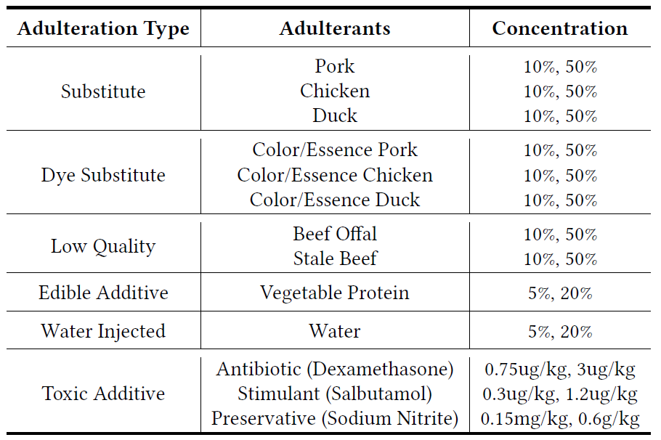
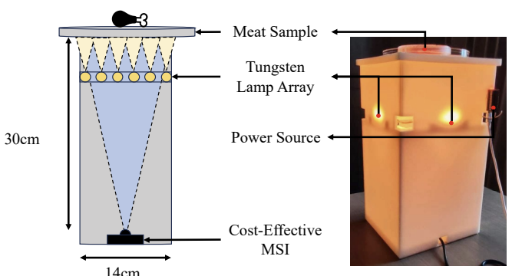
Our Work: MeatSpec
We propose MeatSpec: a consumer-level, user friendly, and accurate meat adulteration detection system based on spectral imaging
Low cost: Less than $60, one hundredth of a fine-grained hyperspectral camera
User-friendly: No need of extra operation, just put the sample at the top of the system
Accurate: Can distinguish six types of adulteration and thirteen various adulterants
put the sample
12.6%
Substitution
User
43.7%
Additives

Slide 6
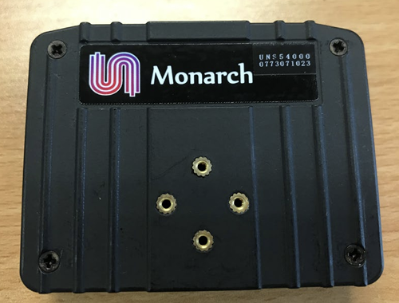
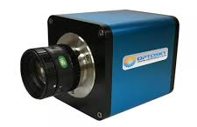
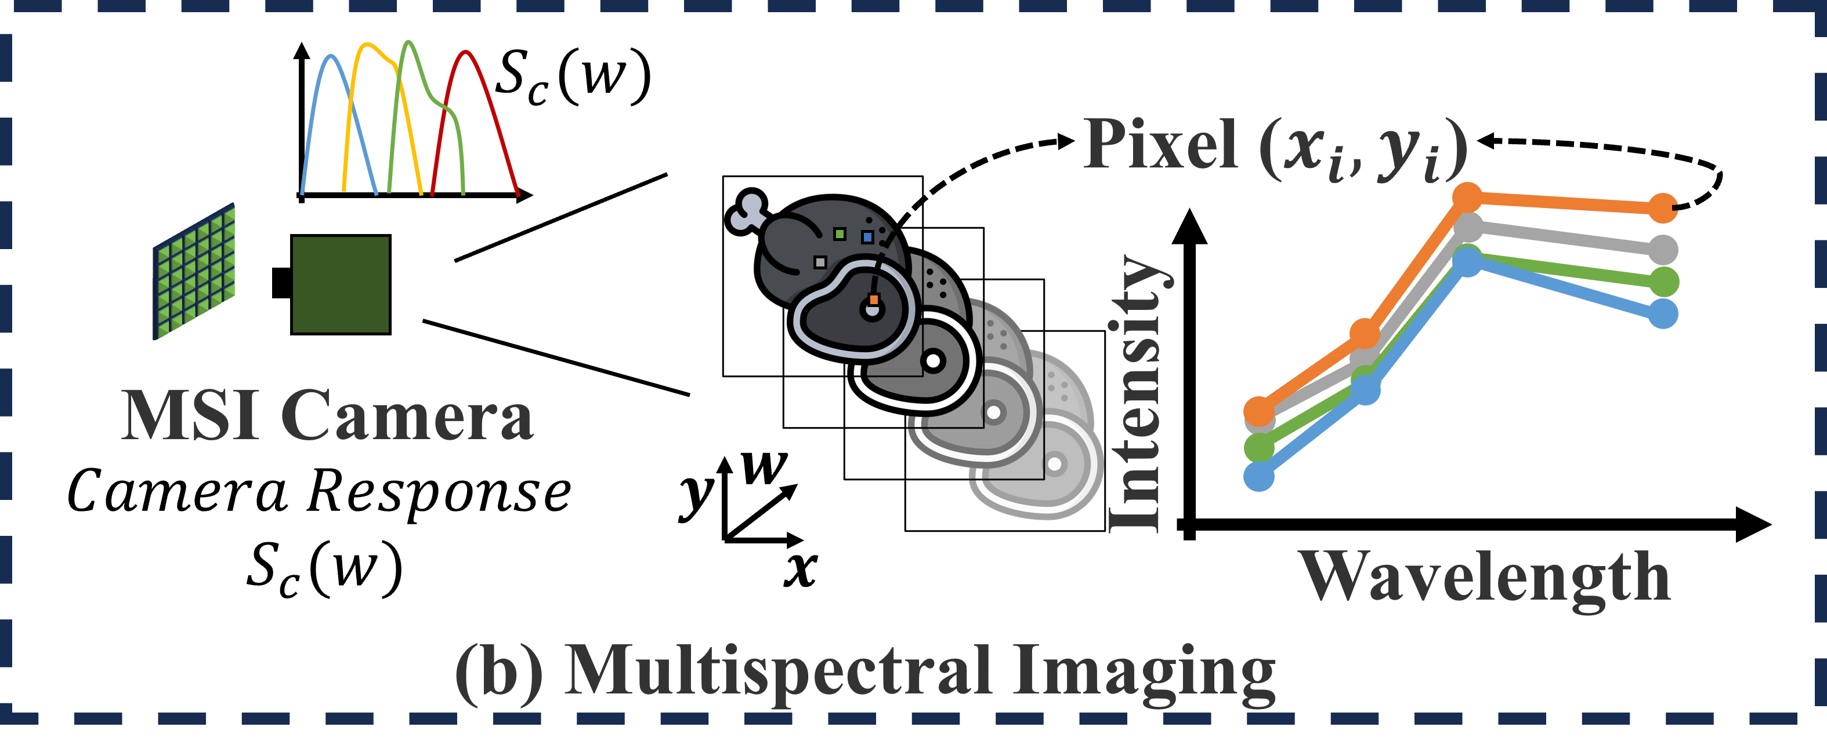
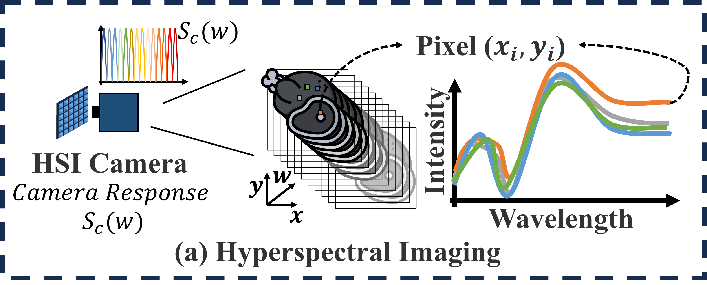
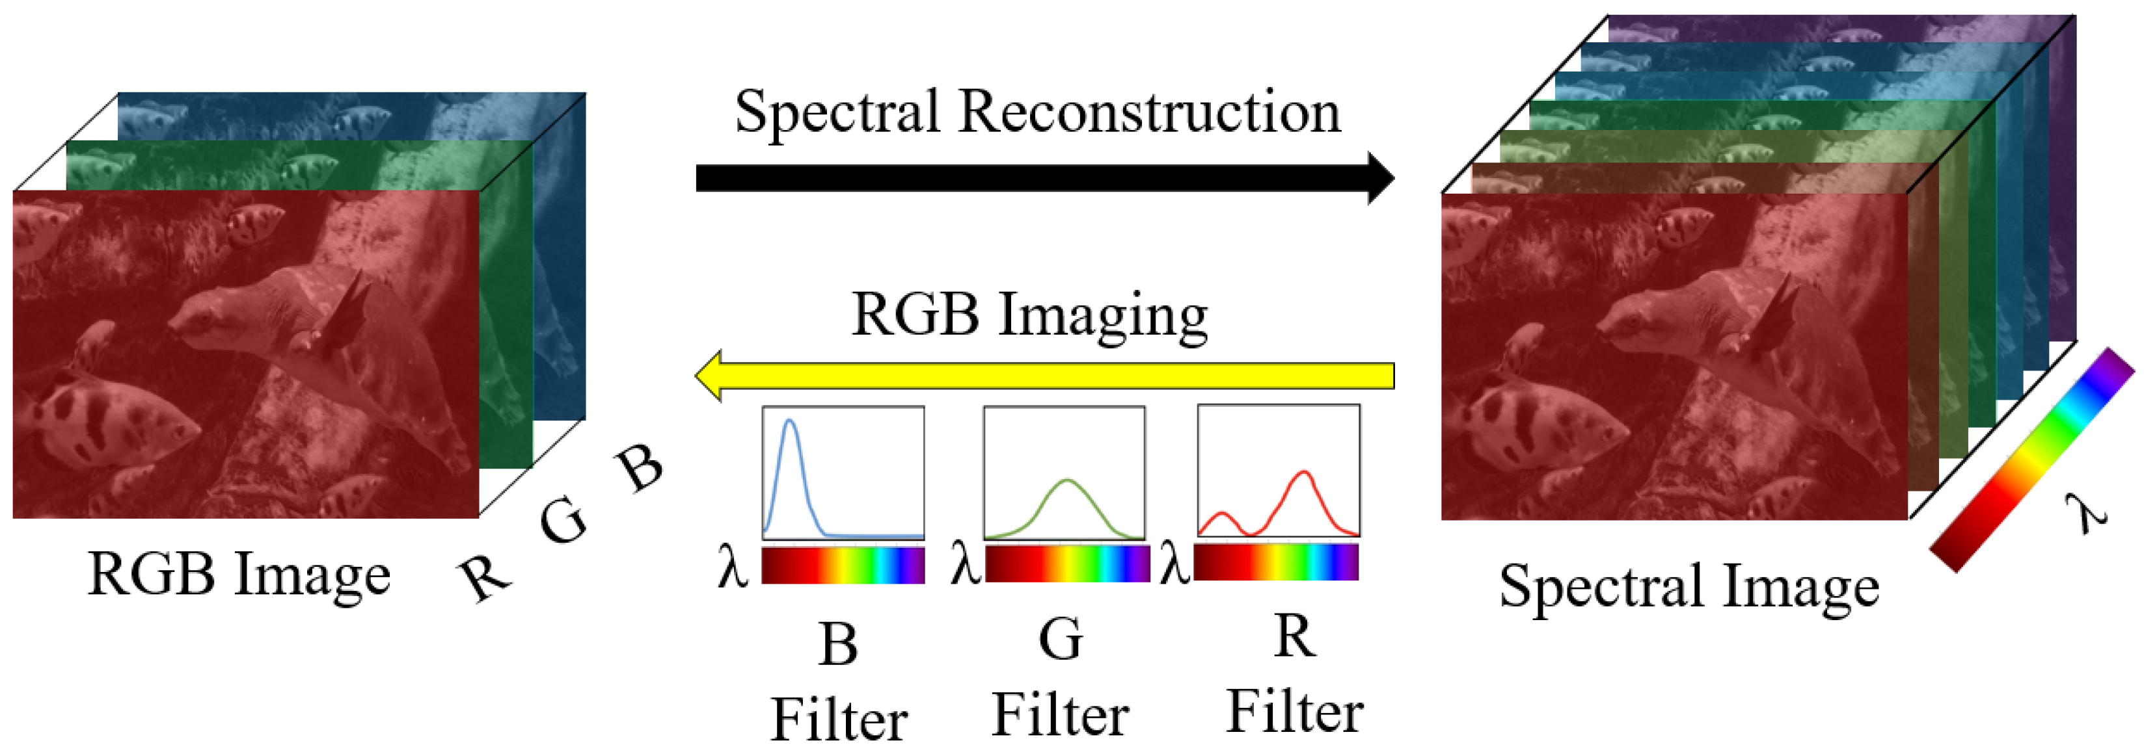
Our Work: MeatSpec
MeatSpec employs a multispectral camera to reduce costs while using spectral reconstruction technology to improve the data quality.
Low-cost device ($50)
HSI
Expensive device ($10000)
MSI
Spectral Reconstruction (SR)
 | Covering Range | Spectral Resolution
MSI | Low | Low
HSI | High | High
Rationale of Spectral Reconstruction
Notes:
The main idea of MeatSpec is to employ a multispectral camera to reduce costs. But, this leads to a decrease in spectral resolution and coverage. So, we utilize the spectral reconstruction technology to improve the data quality. Spectral reconstruction has been proved to be able to recovering fine-grained spectral information from limited spectral measurements, such as RGB, by learning a mapping using amount of pixel-to-pixel paired MSI and HSI data.

Slide 7
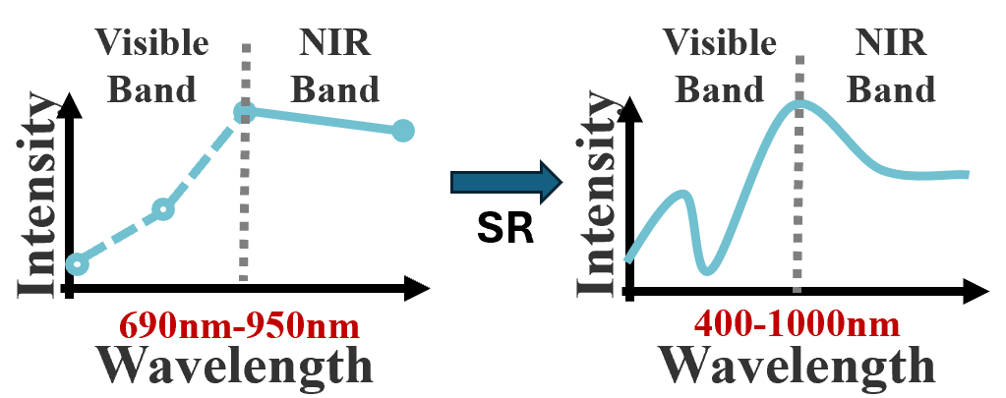
Our Work: MeatSpec
Spectral Reconstruction (SR)
Low-quality data
High-quality data
Applying SR on meat adulteration detection task faces several challenges!
High Similarity of Multispectral Images
Full-Band Reconstruction Error
Lack Spectral Reconstruction Dataset
MSI
HSI
Paired data
Diverse field-of-view and focal length
Notes:
However, applying SR on meat adulteration detection task faces several challenges.
Firstly, The authentic and adulterated samples have similar spectral features. The low-cost multispectral camera worsens the problem due to its coarse-grained spectral resolution. However, existing spectral reconstruction algorithms can hardly restore the subtle differences for two similar MSI.
Secondly, the low-cost multispectral devices can only cover a limited wavelength range that is not sufficient for meat adulteration analysis. When applying existing spectral reconstruction algorithm for full-band reconstruction, the errors and noises in the reconstructed data will hinder its usability for adulteration detection.
Thirdly, Spectral reconstruction algorithms require paired (multispectral images, hyperspectral images) data for training. However, obtaining exactly the paired data is challenging, due to the different hardware parameters of the two devices. And the generated data by simulation contains huge gap with the test data collected in real scenarios.

Slide 8
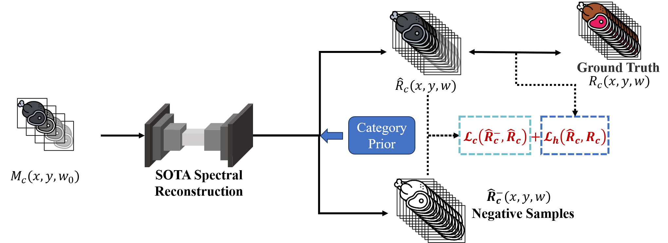
Challenge #1: High Similarity of Multispectral Images
MeatSpec involves adulteration related prior information during the SR training phase.
The contrastive learning is used to enlarge the distances among reconstructed samples belonging to various adulteration types
Cross-type spectral distance increase↑
Contrastive loss for negative samples:
Notes:
To solve the first problem, we propose an application-oriented spectral reconstruction module to restore more distinguishable reconstructed images for the cost-effective multispectral input.
Specifically, we involves adulteration related prior information during the SR training phase and incorporates contrastive learning to enlarges the distances among reconstructed samples belonging to various adulteration types.
We can clear see that by utilizing this approach, the cross-type spectral distance increase a lot.

Slide 9
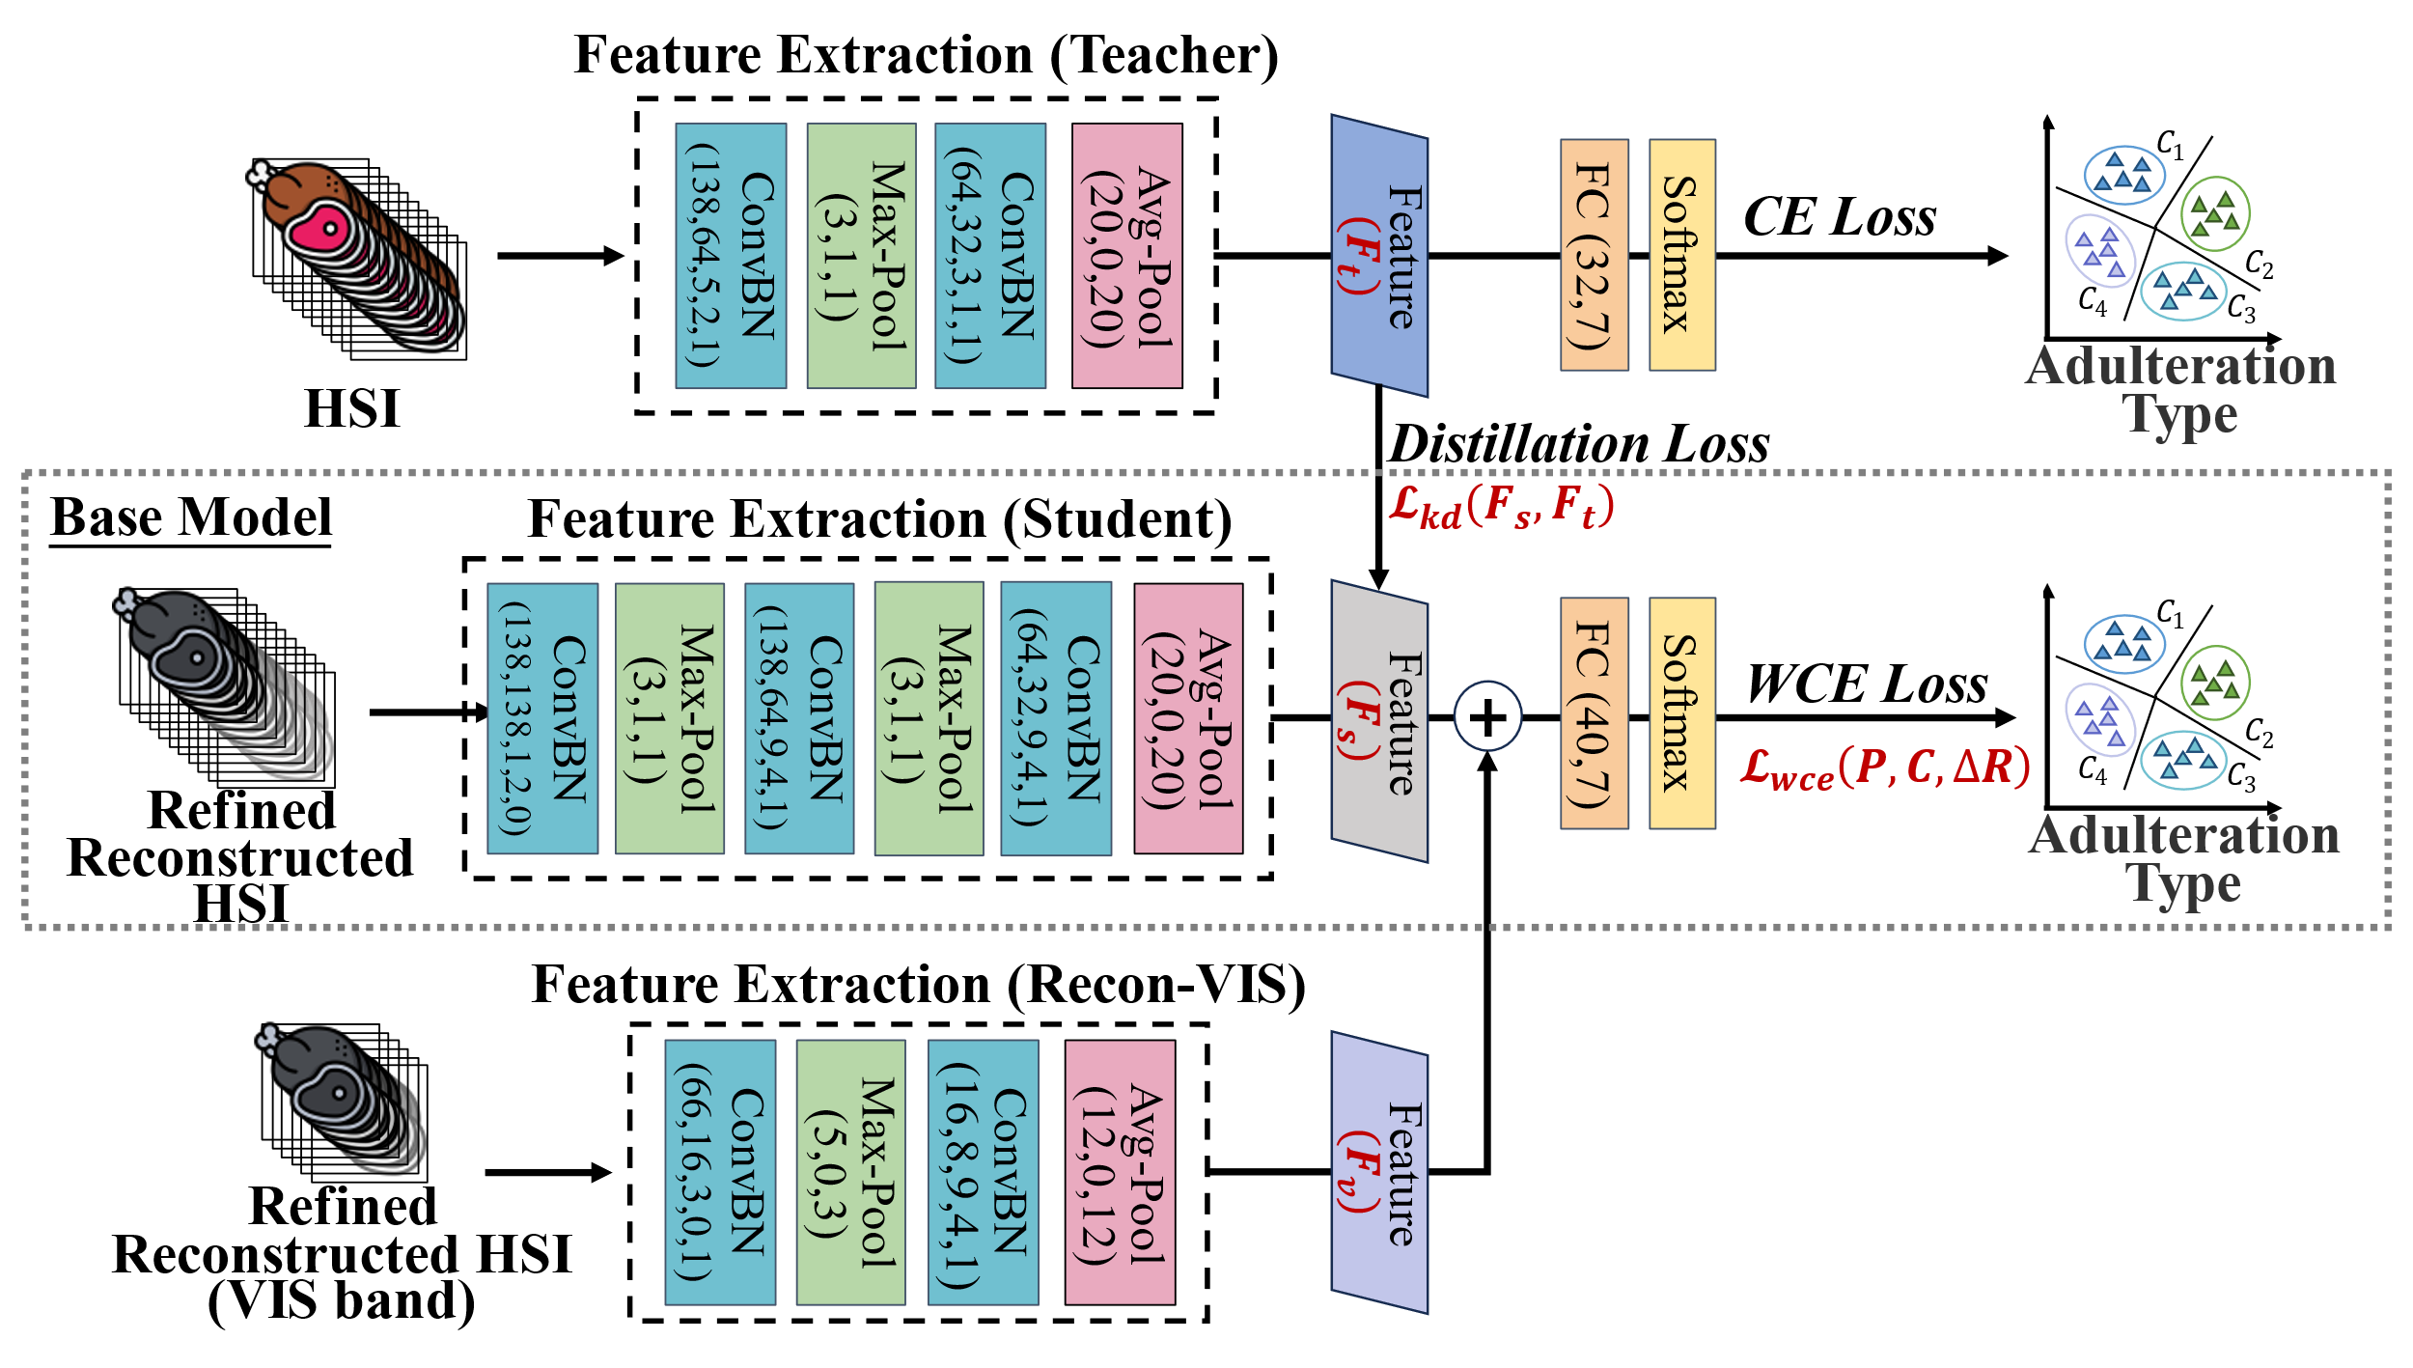
Challenge #2: Full-Band Reconstruction Error
MeatSpec designs distinct feature extractors for different bands according to the error distribution characteristics of the reconstructed spectra
It employs knowledge distillation to align extracted features with the original HSI’s features in the latent feature space
>98% accuracy
Feature Distillation
The reconstructed visible band has more distinguishing information
Extract contrastive-aided information in visible band
Notes:
For the second challeng, to suppress noise and error in full-band reconstructed spectra and extract adulteration-related features, We designs distinct feature extractors for different bands according to the error distribution characteristics of the reconstructed spectra.
In addition, we employ knowledge distillation to align extracted features with the original HSI’s features in the latent feature space.
The teacher model is trained by original HSI images and achieves great accuracy, thus can guide the base model to extract adulteration-related information from the reconstructed data.
Meanwhile, we observe that the reconstructed visible band has more distinguishing information, thus we add an extra extractor for only visible-band to extract contrastive-aided information to further improve the capability of the system.

Slide 10
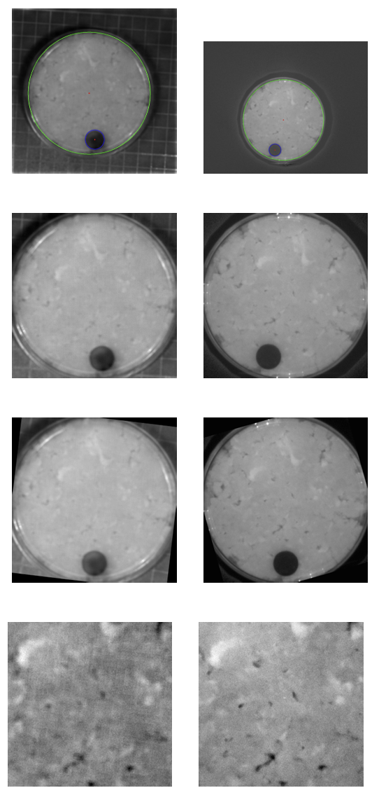
Challenge #3: Lack Spectral Reconstruction Dataset
we design a preprocessing pipeline through image processing algorithms.
Elimination of Ambient Light
Median Filtering and ROI Extraction
Spatial Alignment
Central Area Extraction
We collect a dataset¹:
347 paired MSI and HSI images
13 types of adulterants
2 various concentration
HSI(left) and MSI(right)
1. The dataset is open to be accessed in reference [31].
Notes:
Then, to solve the third challenge, we design a pipeline involves several steps to ensure that the MSI and HSI data are aligned and addresses challenges posed by ambient light influence, resolution differences, and variations in sample location during data collection.
Furthermore, we collect a dataset comprising 347 paired reconstruction training data through our designed pre-processing pipeline.

Slide 11
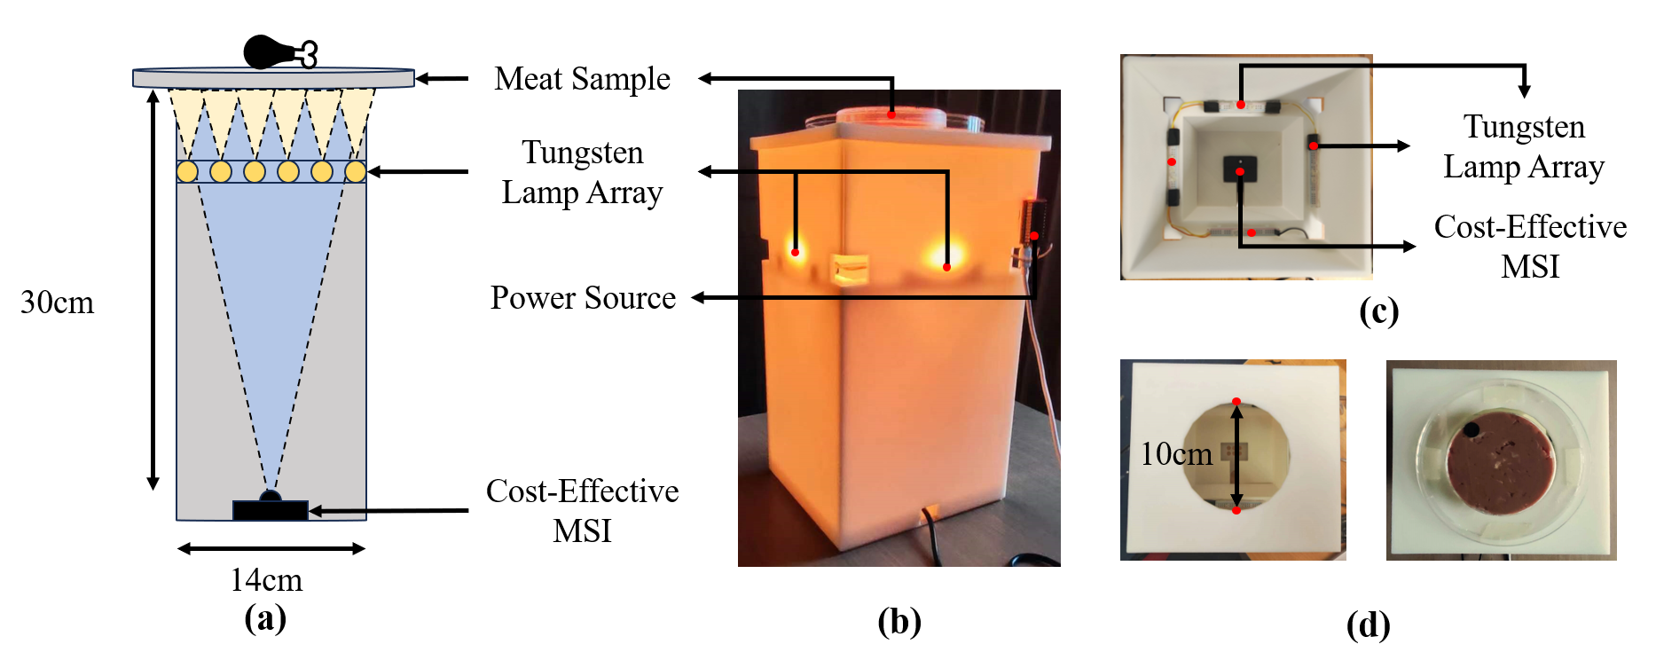
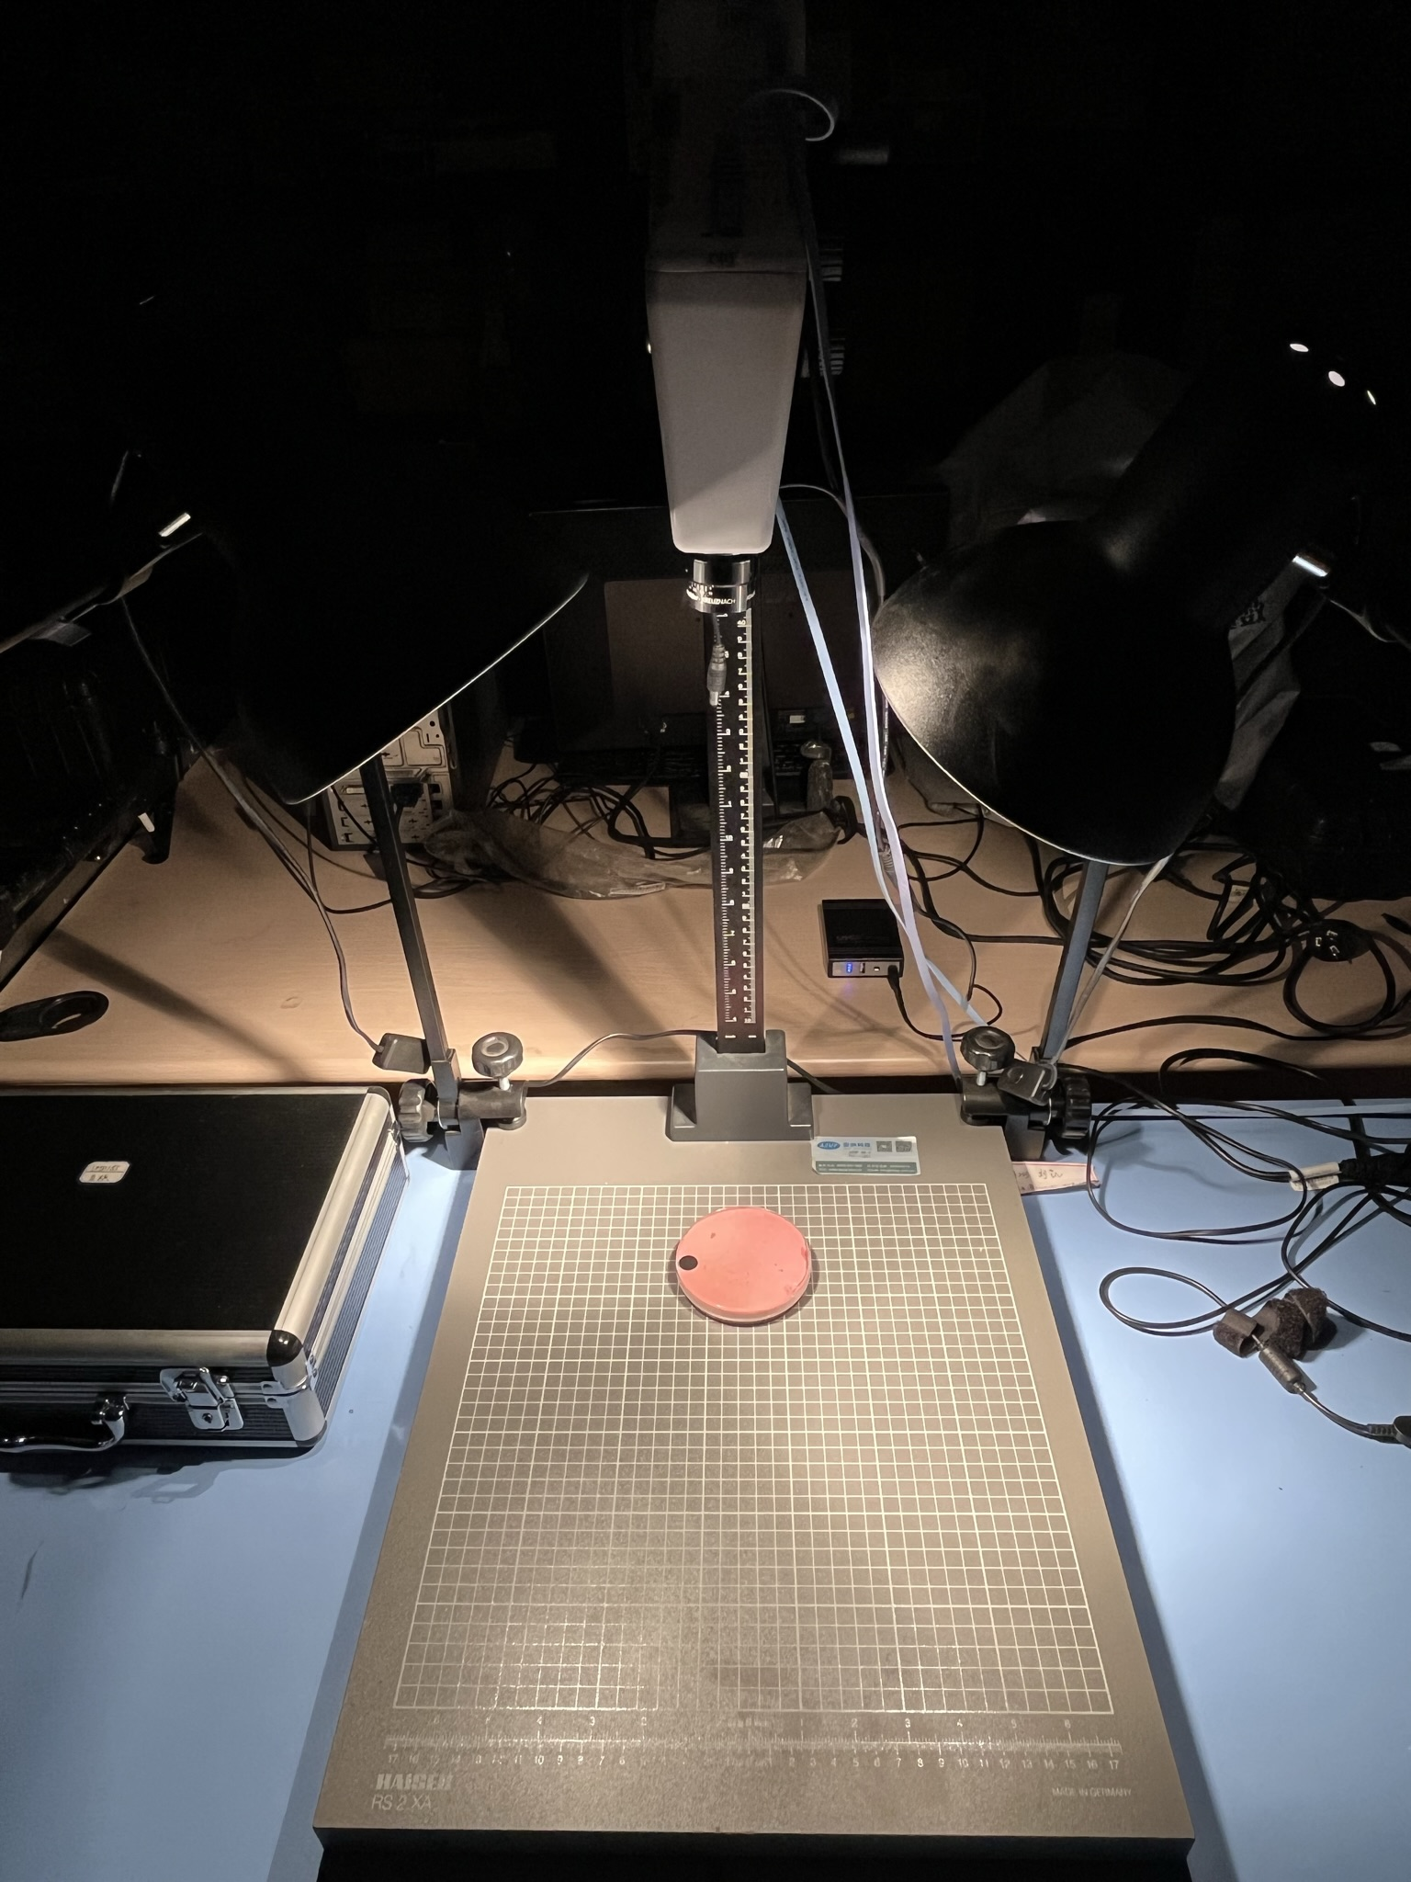
Evaluation Setup
MeatSpec
Monarch MSI Camera (<$60)
10 bands, 690-950nm
Ground truth
Cubert FireflEYE S185 (>$10000)
138 bands, 400-1000nm
Overall evaluation: Stratified 5-fold cross validation
Robustness evaluation: Train on normal setup and test on following changes
Notes:
We implement a compact and low-cost prototype using off-the-shelf multispectral camera that contains 10 different bands. The original HIS images are collected by a laboratory hyperspectral imaging device, which costs more than 10 thousand dollars.
We conduct stratified 5-fold cross validation to show the overall performance of sys and compare with several baselines. In addition, we evaluate the robustness of the system by training the system on normal setups and test on various experimental and environmental changes.

Slide 12
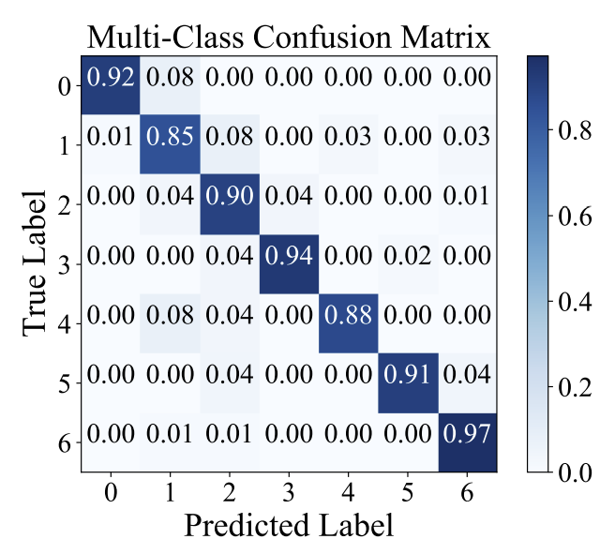
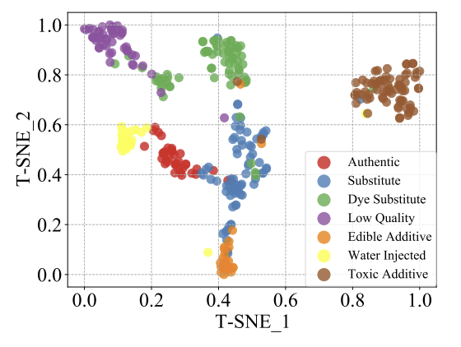
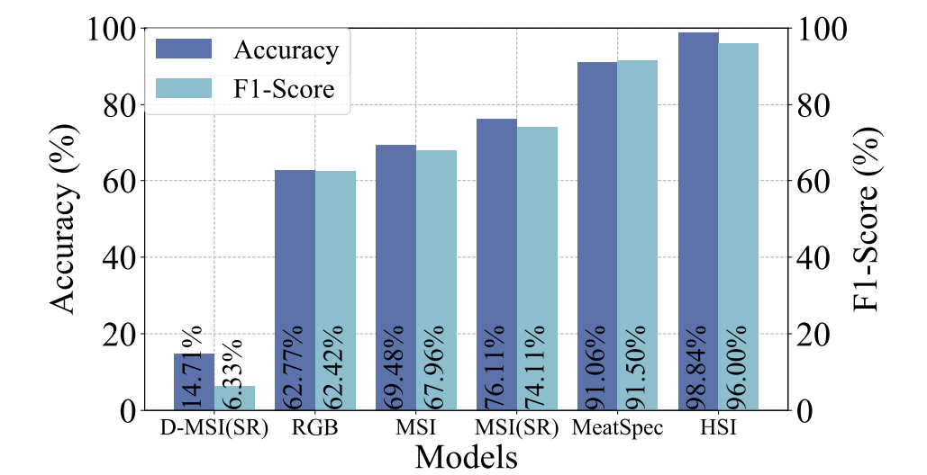
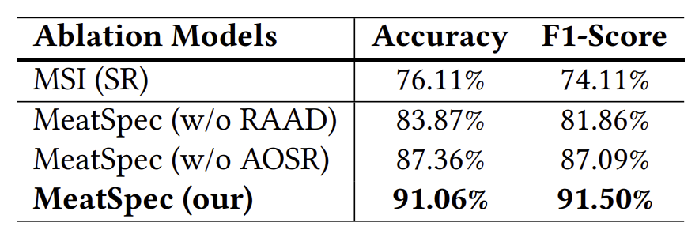
Evaluation: Overall performance
MeatSpec achieves 91.06% accuracy, a 21.58% improvement over commercial systems. Only 7.78% less than professional hyperspectral equipment, but at a hundredth of the price.
Notes:
In general, MeatSpec achieves 91.06% accuracy, with more than 20% improvement over commercial systems. And it’s only about 8% less than professional hyperspectral equipment. But the cost of our system is only one hundredth of the laboratory one.

Slide 13
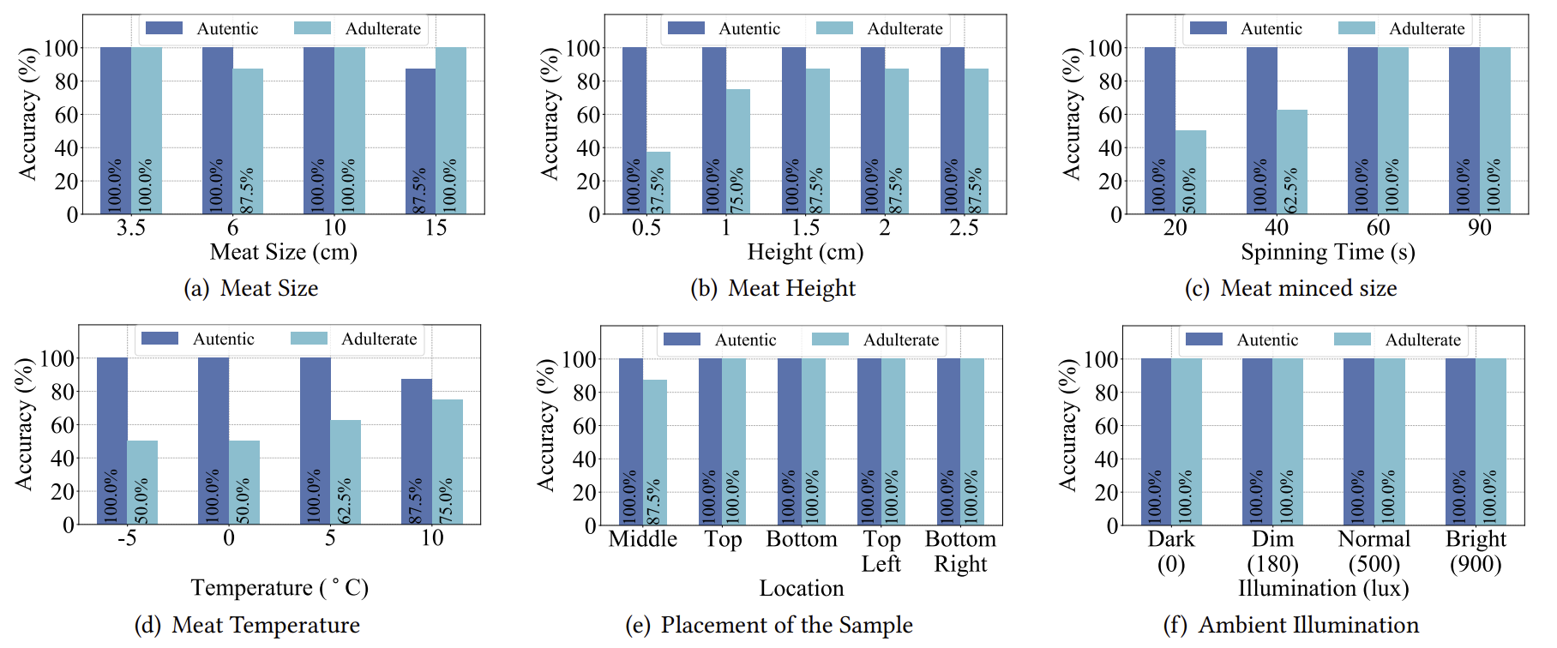
Evaluation: Robustness
MeatSpec is robust under majority of the environments and have good extendibility to new meat types and concentration.
Notes:
In addition, meatSpec is robust in most environments, including different sample representations and different environments, such as lighting conditions, and also have good scalability to new meat types and concentrations.

Slide 14
Conclusion
We develop MeatSpec, the first consumer-grade meat adulteration detection system that can accurately distinguish authentic meat from various adulterants and identify the types of adulteration.
put the sample
Low cost
User-friendly
Accurate
User

Slide 15
Thank you!

